Slide 1

Smart Power Socket Using Internet of Things
Team Members:
Surya Roshanth V -20i348
Venkatesh M - 20i354
DineshKumar GD - 21i461
Kishore S - 21i463
Project Guide:
Dr. Vairam T

Slide 2
AGENDA:
Problem Statement
Objective
Introduction
Proposed Methodology
Requirement
Design
Implementation
Comparison
Conclusion
References

Slide 3
INTRODUCTION:
A smart power socket is an electrical outlet that can be controlled remotely via a smartphone or other networked device.It allows users to turn devices plugged into it on or off remotely, monitor energy usage, and sometimes schedule when devices turn on or off.
IoT refers to the network of physical objects ("things") embedded with sensors, software, and other technologies to connect and exchange data with other devices and systems over the internet.
It enables devices to communicate and interact with each other, providing opportunities for automation, monitoring, and control.

Slide 4
By connecting the smart power socket to the internet, it becomes part of the IoT ecosystem.
Users can remotely control the socket through a smartphone app or a web interface, enabling convenient management of connected devices from anywhere with an internet connection.
IoT connectivity allows for data collection from the smart power socket, such as energy usage statistics and device status, which can be analyzed for insights and optimization.

Slide 5
LSTM is a type of recurrent neural network (RNN) architecture designed to process sequences of data and remember long-term dependencies.It is particularly useful for analyzing time-series data, such as sequential energy consumption readings from a smart power socket.
LSTM algorithms can be employed to predict future energy consumption based on historical usage patterns.
By training the LSTM model with past energy consumption data, it can learn complex patterns and make accurate predictions about future demand.

Slide 6
PROBLEM STATEMENT
The primary challenge that addresses the inefficient management of energy resources.
Traditional methods of energy consumption monitoring often lack accuracy and real-time insights, leading to suboptimal resource allocation,transparency, efficiency, and accountability.

Slide 7
OBJECTIVE
The primary objective is to develop an advanced system for energy management, combining cutting-edge technology and data analytics.
This system emphasizes real-time energy monitoring and precise demand prediction, with the ultimate goal of empowering users to make informed decisions about their energy usage.

Slide 8
LITERATURE SURVEY
Author | Titles | Technologies and Algorithms | Limitations
Rohit Andore,S.S. Kulkarni,A. G Thosar, | Energy Meter and Power Theft Monitoring System | Wifi,Zigbee Communication Protocol, Microcontroller | Depends on Wi-Fi connectivity may limit its effectiveness in areas with poor internet infrastructure
Sumit Mohanty,M. Mohamed Iqbal,Parvathy Thampi M.S. | Controlling and Monitoring of Power Theft using Internet of Things | IoT-based monitoring, ZigBee Communication Protocol Real-time data analysis | Implementation and Deployment of IOT devices and Infrastructure is very high
Taimur Shahzad Gill,Durr E Shehwar,Hira Memon,Sobia Khanam,Ali Ahmed,Urooj Shaukat,Abdul Mateen,Syed Sajjad Haider Zaidi, | IoT Based Smart Power Quality Monitoring and Electricity Theft Detection System | Sensor network, IoT technology | Implementation and maintenance costs may be prohibitive for widespread deployment, particularly in areas with limited resources

Slide 9
Sanujit Sahoo,Daniel Nikovski,Toru Muso,Kaoru Tsuru, | Electricity theft detection using smart meter data | Temperature-dependent predictive model | Increases more cost complexity.
Nitin K Mucheli,Umakanta Nanda,D Nayak,P K Rout,S K Swain,S K Das,S M Biswal | Smart Power Theft Detection System | Wifi,Zigbee Communication Protocol,Microcontrollers | It faces challenges in accurately identifying locations in densely populated areas with complex power distribution networks.
Aswini R.,Keerthihaa V., | IoT Based Smart Energy Theft Detection and Monitoring System for Smart Home | Microcontroller, Passive infrared sensor (PIR) | Accurate data collection and analysis, which can be challenging in environments.

Slide 10
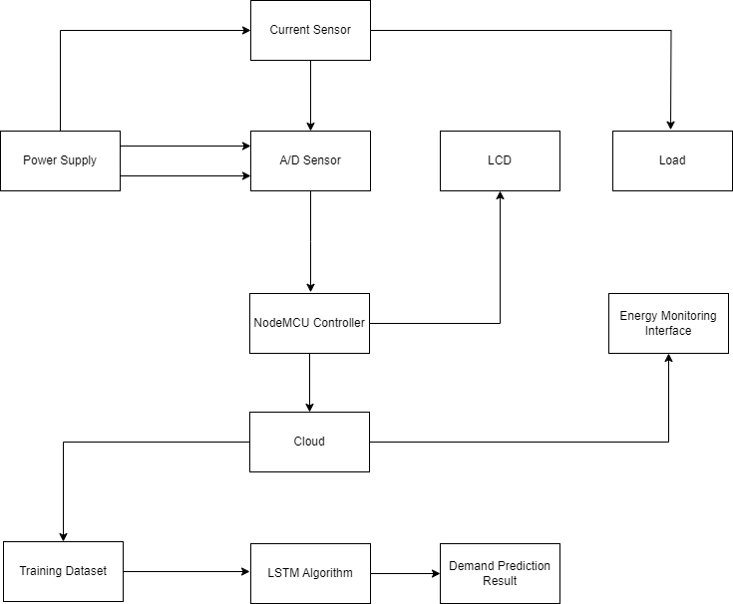
PROPOSED METHODOLOGY:

Slide 11
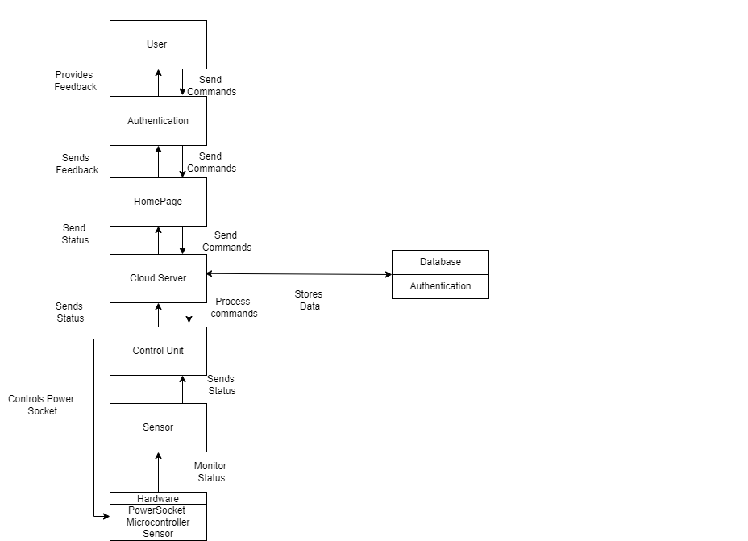
FLOW DIAGRAM:

Slide 12
WORKING
1.The system combines hardware (voltage and current sensors, NodeMCU controller) and software (ThingSpeak cloud platform, LSTM neural networks) components for energy monitoring and demand prediction.
2.Voltage and current sensors, along with an analog to digital converter module, enable real-time measurement of energy consumption.
3.The NodeMCU Equipped with Wi-Fi capabilities collects, processes, and transmits data from sensors to the ThingSpeak cloud platform securely using a secret API key.

Slide 13
4.ThingSpeak provides cloud-based services for storing and analyzing data from connected devices, facilitating secure transmission and visualization of energy consumption data.
5.Long Short-Term Memory (LSTM) neural networks are utilized for demand prediction, particularly suited for time series data analysis.

Slide 14
Long Short Term Memory:
LSTM (Long Short-Term Memory) is a recurrent neural network (RNN) architecture widely used in Deep Learning. It excels at capturing long-term dependencies, making it ideal for sequence prediction tasks.
It's like having a smart assistant that remembers important details from the past to predict what might happen next.
Unlike regular neural networks, LSTM has a special memory that can remember long-term patterns and relationships in the data, making it perfect for predicting future trends.

Slide 15
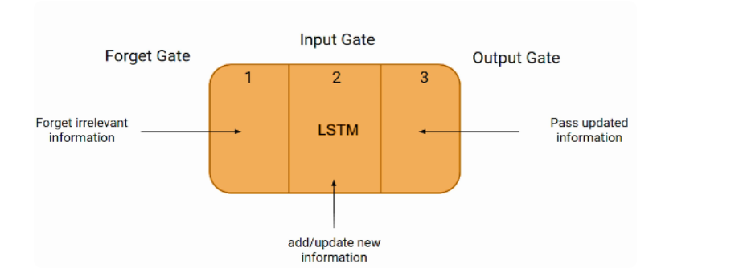
LSTM ARCHITECTURE:

Slide 16
Step1 Data preparation:
Historical energy consumption data is preprocessed and divided into training and testing sets for LSTM model training.
Step2 Model training:
The LSTM model learns patterns and relationships in historical data during the training phase to make accurate predictions about future energy demand.
Step3 Demand forecasting:
Trained LSTM model predicts future energy demand based on input data, providing insights for resource planning and optimization.

Slide 17
Step4:Visualization
Predicted demand data is visualized, aiding users in understanding future energy requirements for effective decision-making.

Slide 18
Comparison with Prophet Model
Actual power consumption data and combines it with the forecasted values from both the Prophet and LSTM models into one dataframe.
Then, it utilizes matplotlib to visualize these datasets on a single graph.
The x-axis typically represents time, showing dates in this case, while the y-axis indicates power consumption values.
Labels, titles, and gridlines are added to the plot to enhance clarity, with the x-axis labels rotated for easier reading

Slide 19
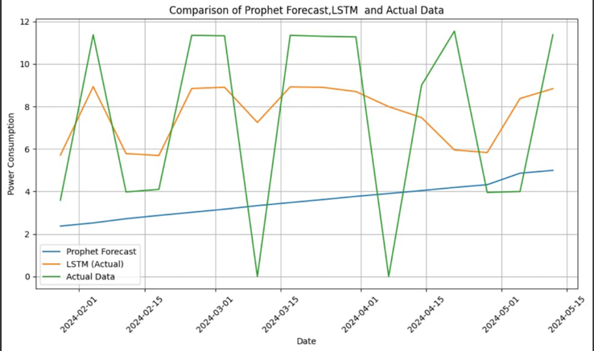
the above figure shows the Actual power consumption data ,combined with the forecasted values from both the Prophet and LSTM models into one dataframe. Then, it utilizes matplotlib to visualize these datasets on a single graph. The x-axis typically represents time, showing dates in this case, while the y-axis indicates power consumption values. Labels, titles, and gridlines are added to the plot to enhance clarity, with the x-axis labels rotated for easier reading.

Slide 20
Demand Prediction
Demand prediction using LSTM neural networks is utilized to forecast future energy demand based on historical energy consumption data.
The purpose of demand prediction in power sockets is to anticipate the amount of energy that will be required in the future, enabling efficient planning and allocation of resources.
Ultimately, demand prediction helps in optimizing energy generation, distribution, and utilization, leading to reduced wastage, improved resource allocation, and alignment with actual energy requirements.
To use LSTM for demand prediction the following steps to be followed.

Slide 21
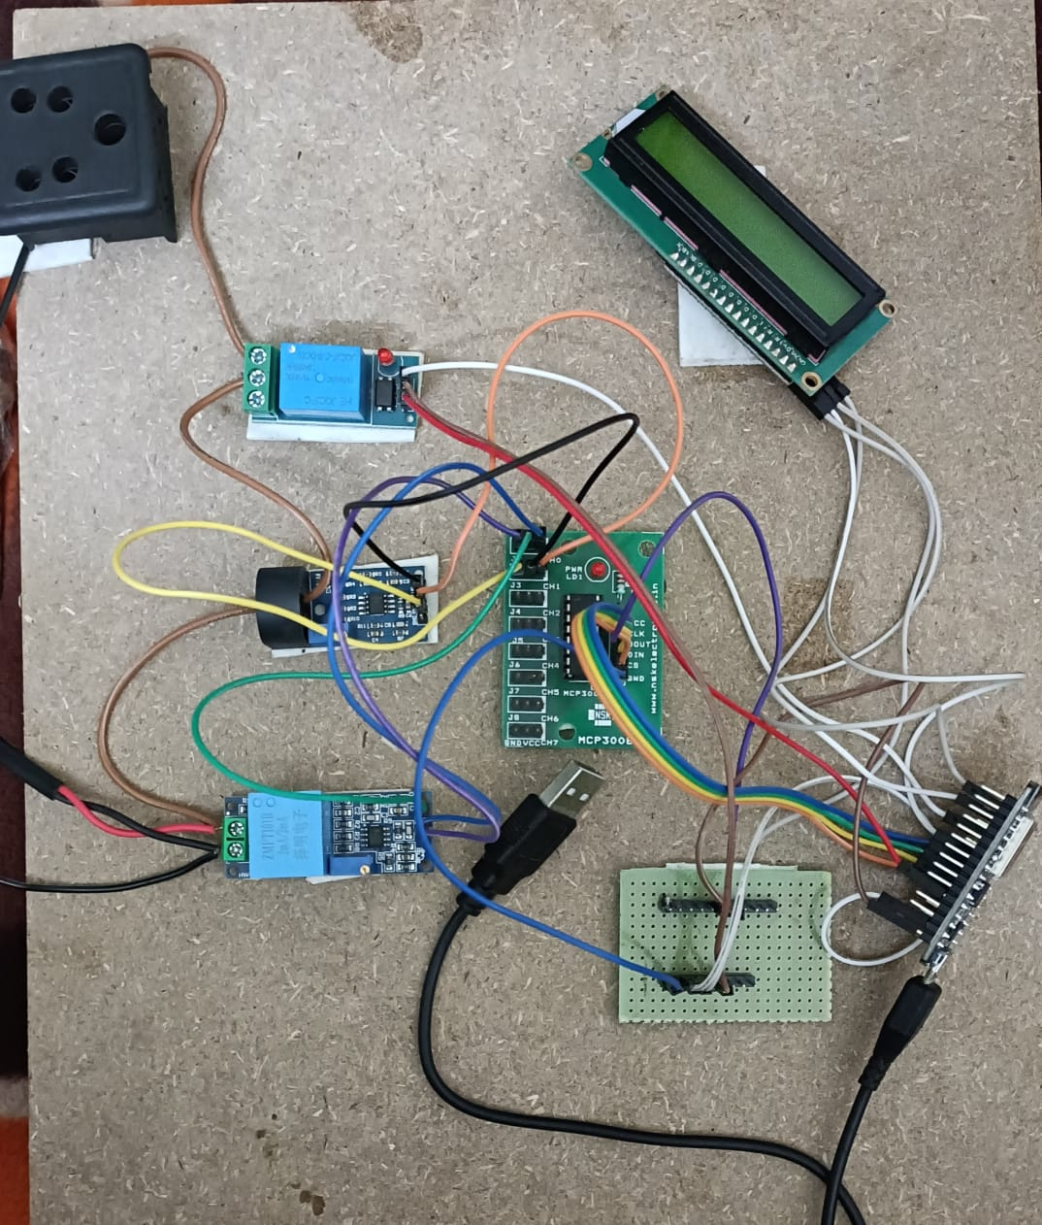
HARDWARE:

Slide 22
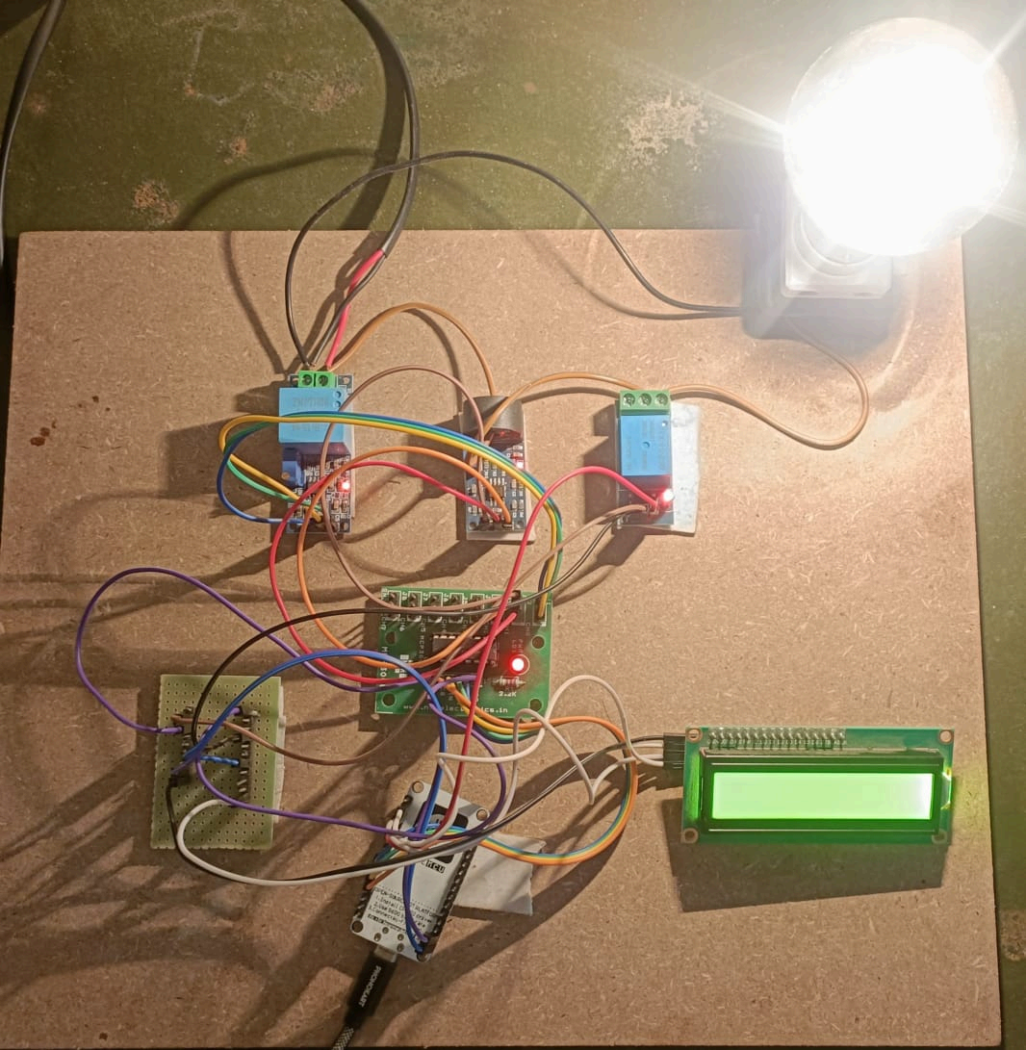
IMPLEMENTATION:
the above figure shows that fully connected hardware part of the smart power socket, When the current flow must be started by entering 1 "On," enter the values for the number of seconds in the home page and then click the submit button,the load will be turned on.

Slide 23
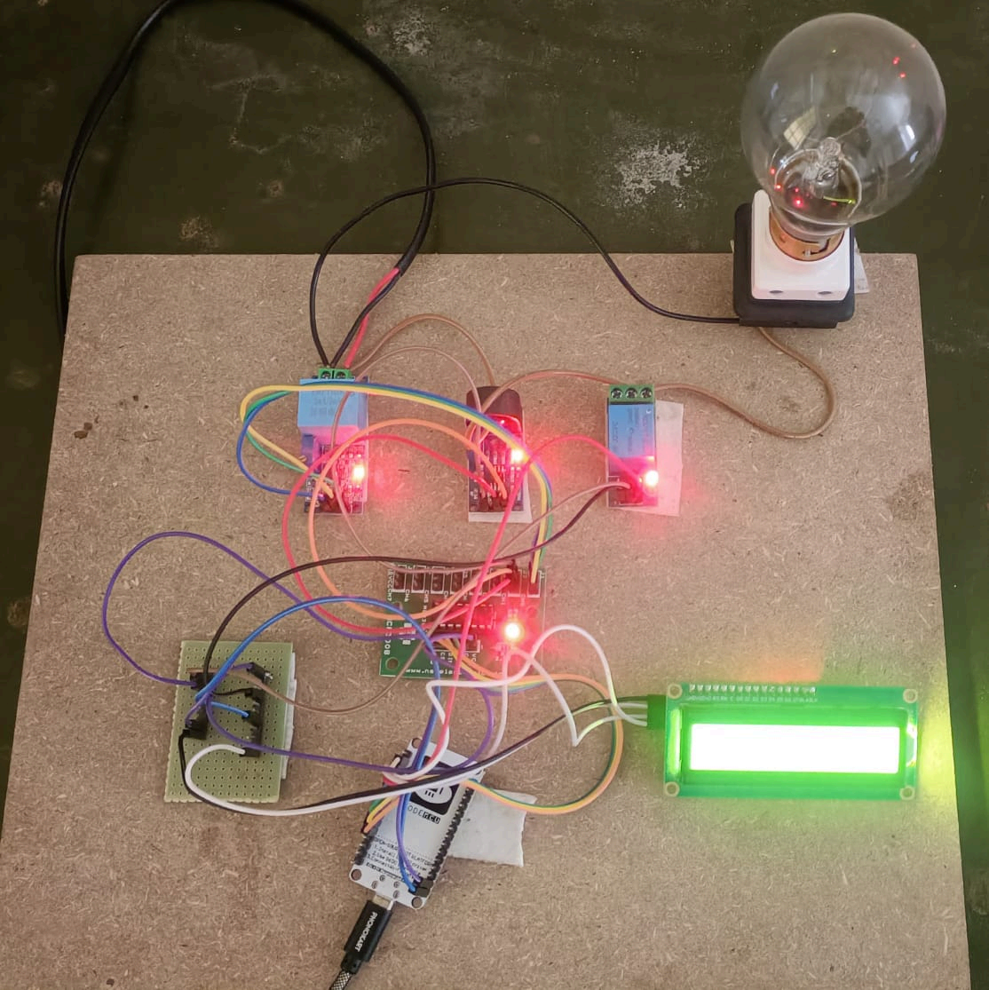
the above figure shows that fully connected hardware part of the smart power socket, When the current flow must be started by entering 2 "Off," enter the values for the number of seconds in the home page and then click the submit button,the load will be turned off.

Slide 24
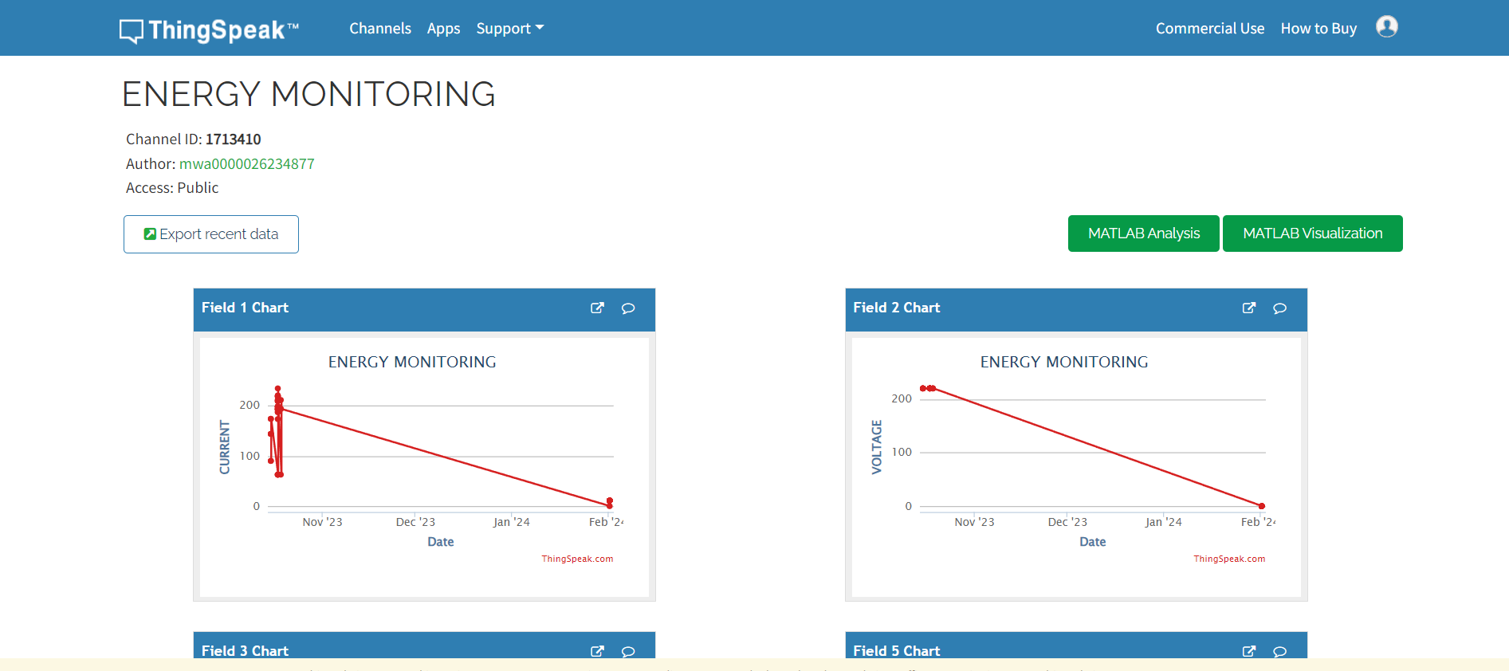
IMPLEMENTATION:
The above figure shows that when the nodemcu sends the data from hardware to thingspeak and shows the graphs.

Slide 25
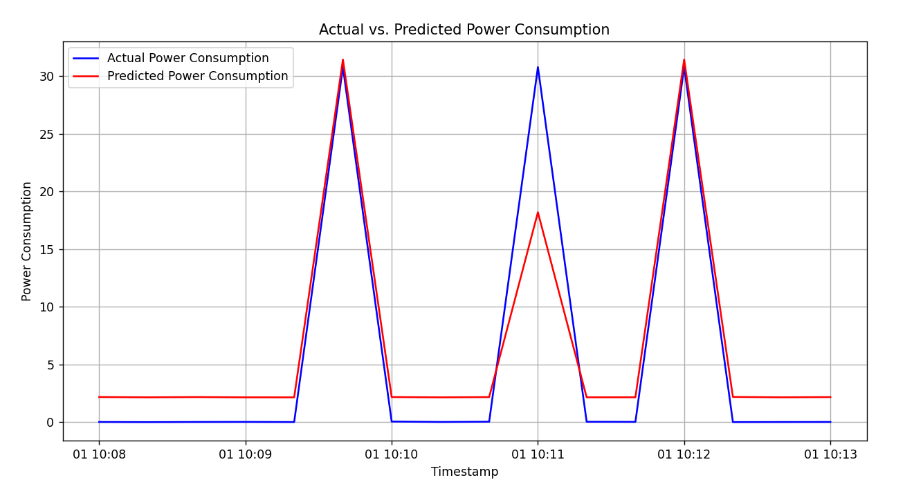
IMPLEMENTATION:
the above figure shows the actual and predicted power consumption of LSTM,X axis represents timestamp and Y axis represents power consumption data.

Slide 26
SPECIFICATION OF SYSTEM DEVELOPED:
Software
Arduino IDE
Thonny IDE
ThingSpeak
Languages
Python,C++,HTML,CSS,JavaScript
System Details:
RAM:12GB
DiskSpace:100GB

Slide 27
CONCLUSION
The Smart Power Socket project represented a significant advancement in energy resource management by integrating Internet of Things and innovative methodologies. It mainly focused on real-time energy monitoring, demand prediction, and cloud-based integration, addressing the inefficiencies and limitations of traditional energy management systems. The implementation of Long Short-Term Memory (LSTM) allowed for accurate forecasts of future energy demand, facilitating efficient resource allocation and optimization. The integration with ThingSpeak provided a secure and accessible platform for storing and visualizing energy consumption data, enhancing transparency and accountability in energy management practices..

Slide 28
[1] “R. Andore, S. S. Kulkarni and A. G. Thosar, "Energy Meter and Power Theft Monitoring System," 2023 IEEE International Students' Conference on Electrical, Electronics and Computer Science (SCEECS), Bhopal, India, 2023, pp. 1-6, doi: 10.1109/SCEECS57921.2023.10062967.”
[2] S. Mohanty, M. Mohamed Iqbal and P. Thampi M.S., "Controlling and Monitoring of Power Theft using Internet of Things," 2021 International Conference on Design Innovations for 3Cs Compute Communicate Control (ICDI3C), Bangalore, India, 2021, pp. 111-115, doi: 10.1109/ICDI3C53598.2021.00031..
[3] .T. Shahzad Gill et al., "IoT Based Smart Power Quality Monitoring and Electricity Theft Detection System," 2021 16th International Conference on Emerging Technologies (ICET), Islamabad, Pakistan, 2021, pp. 1-4, doi: 10.1109/ICET54505.2021.9689908.
[4] S. Sahoo, D. Nikovski, T. Muso and K. Tsuru, "Electricity theft detection using smart meter data," 2015 IEEE Power & Energy Society Innovative Smart Grid Technologies Conference (ISGT), Washington, DC, USA, 2015, pp. 1-5, doi: 10.1109/ISGT.2015.7131776.
References:

Slide 29
[5] N. K. Mucheli et al., "Smart Power Theft Detection System," 2019 Devices for Integrated Circuit (DevIC), Kalyani, India, 2019, pp. 302-305, doi: 10.1109/DEVIC.2019.8783395.
[6] A. R. and K. V., "IoT Based Smart Energy Theft Detection and Monitoring System for Smart Home," 2020 International Conference on System, Computation, Automation and Networking (ICSCAN), Pondicherry, India, 2020, pp. 1-6, doi: 10.1109/ICSCAN49426.2020.9262411

Slide 30
THANK YOU

